Slide 1
Reverse Engineering Techniques

Slide 2
4.6 Techniques Used for Reverse Engineering
The well-known analysis techniques that facilitate reverse engineering are:
Lexical analysis.
Syntactic analysis.
Control flow analysis.
Data flow analysis.
Program slicing.
Visualization.
Program metrics.

Slide 3
4.6.1 Lexical Analysis
Lexical analysis is the process of decomposing the sequence of characters in the source code into its constituent lexical units.
A program performing lexical analysis is called a lexical analyzer, and it is a part of a programming language’s compiler.
Typically it uses rules describing lexical program structures that are expressed in a mathematical notation called regular expressions.
Modern lexical analyzers are automatically built using tools called lexical analyzer generators, namely, lex and flex (fast lexical analyzer).

Slide 4
4.6.2 Syntax Analysis
Syntactic analysis is performed by a parser.
Parser is a compiler that is used to break the data into smaller elements coming from lexical analysis phase.
A parser takes input in the form of sequence of tokens and produces output in the form of parse tree
Similar to syntactic analyzers, parsers can be automatically constructed from a description of the programatical properties of a programming language.
YACC is one of the most commonly used parsing tools.
Two types of representations are used to hold the results of syntactic analysis:
parse tree and abstract syntax tree.
Notes:
parser is a program or component of a program that analyzes the syntax of input data (usually text) according to the rules of a formal grammar. It breaks down the input into its constituent parts and often generates a data structure representing the input in a way that can be easily manipulated or processed further.

Slide 5
4.6.2 Syntax Analysis
A parse tree contains details unrelated to actual program meaning, such as the punctuation, whose role is to direct the parsing process.
Grouping parentheses are implicit in the tree structure, which can be trimmed from the parse tree.
Removal of those extraneous details produces a structure called an Abstract Syntax Tree (AST).
An AST contains just those details that relate to the actual meaning of a program.
Many tools have been based on the AST concept; to understand a program, an analyst makes a query in terms of the node types.
The query is interpreted by a tree walker to deliver the requested information.

Slide 6
4.6.3 Control Flow Analysis
After determining the structure of a program, control flow analysis (CFA) can be performed on it.
The two kinds of control flow analysis are:
Intraprocedural: It shows the order in which statements are executed within a subprogram.
Interprocedural: It shows the calling relationship among program units.
•
I ntraprocedural analysis:
The idea of basic blocks is central to constructing a Control flow graph (CFG).
A basic block is a maximal sequence of program statements such that execution enters at the top of the block and leaves only at the bottom via a conditional or an unconditional branch statement.
A basic block is represented with one node in the CFG, and an arc indicates possible flow of control from one node to another.
A CFG can directly be constructed from an AST (Abstract Syntax Tree) by walking the tree to determine basic blocks and then connecting the blocks with control flow arcs.

Slide 7
4.6.3 Control Flow Analysis
I nterprocedural analysis:
Interprocedural analysis is performed by constructing a call graph.
Calling relationships between subroutines in a program are represented as a call graph which is basically a directed graph.
Specifically, a procedure in the source code is represented by a node in the graph, and the edge from node f to g indicates that procedure f calls procedure g.
Call graphs can be static or dynamic. A dynamic call graph is an execution trace of the program.
Thus a dynamic call graph is exact, but it only describes one run of the program.
On the other hand, a static call graph represents every possible run of the program.

Slide 8
4.6.4 Data Flow Analysis
Data flow analysis (DFA) concerns how values of defined variables flow through and are used in a program.
CFA can detect the possibility of loops, and DFA can also determine data flow anomalies.
One example of data flow anomaly is that an undefined variable is referenced.
Data flow analysis enables the identification of code that can never execute, variables that might not be defined before they are used, and statements that might have to be altered when a bug is fixed.
•

Slide 9
4.6.4 Data Flow Analysis
Control flow analysis cannot answer the question: Which program statements are likely to be impacted by the execution of a given assignment statement?
To answer this kind of questions, an understanding the definitions of variables and references (uses) of variables is required.
If a variable appears on the left hand side of an assignment statement, then the variable is said to be defined.
If a variable appears on the right hand side of an assignment statement, then it is said to be referenced in that statement.
•

Slide 10
4.6.5 Program Slicing
Program slicing has served as the basis of numerous tools.
In Weiser’s definition, a slicing criterion of a program P is S < p; v > where p is a program point and v is a subset of variables in P.
A program slice is a portion of a program with an execution behavior identical to the initial program with respect to a given criterion, but may have a reduced size.
A backward slice with respect to a variable v and a given point p comprises all instructions and predicates which affect the value of v at point p.
•
Notes:
Forward slicing can be used to predict the parts of a program that will be affected by a modification. x = 1; y = 2; z = y-2; r = x; z = x+y; /* the slice point is the end of the program */. A backward slice – simply a version of the original program with some parts missing – can be compiled and executed.

Slide 11
4.6.5 Program Slicing
Backward slices answer the question “What program components might effect a selected computation?”
Forward slicing answers the question “What program components might be effected by a selected computation?”
The dual of backward slicing is forward slicing.
•

Slide 12
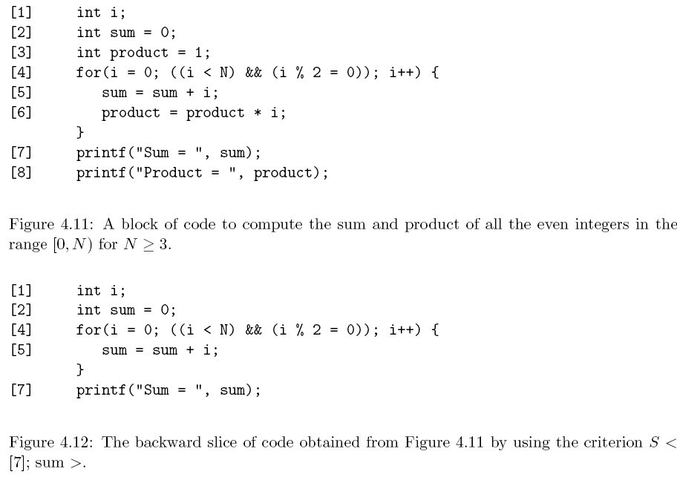
4.6.5 Program Slicing:Example of Backward Slice
Notes:
Forward slicing can be used to predict the parts of a program that will be affected by a modification. x = 1; y = 2; z = y-2; r = x; z = x+y; /* the slice point is the end of the program */. A backward slice – simply a version of the original program with some parts missing – can be compiled and executed.

Slide 13
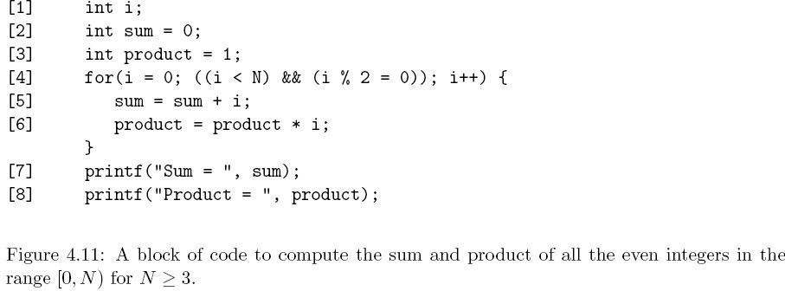
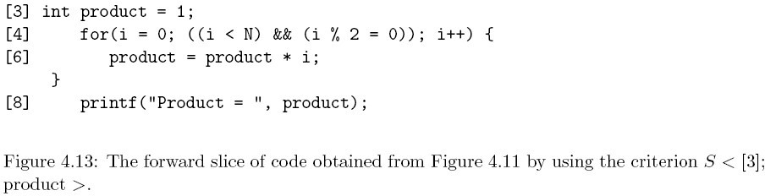
4.6.5 Program Slicing: Example of Forward Slice
Notes:
Forward slicing can be used to predict the parts of a program that will be affected by a modification. x = 1; y = 2; z = y-2; r = x; z = x+y; /* the slice point is the end of the program */. A backward slice – simply a version of the original program with some parts missing – can be compiled and executed.

